Slide 1
















Material Safe
Postings
Radiation Area Boundary
100 cm² Smears
1
2
3
4
5
6
7
8
9
10
11
12
13
14
15
16
17
18
19
20
21
22
23
24
Rad Waste
LSC Smears
1
2
3
4
5
6
7
8
µR/hr
Bricks / Shielding
mR/hr
Dose rates in µR/hr
#
= smear location
= LSC Smears
#

Slide 2
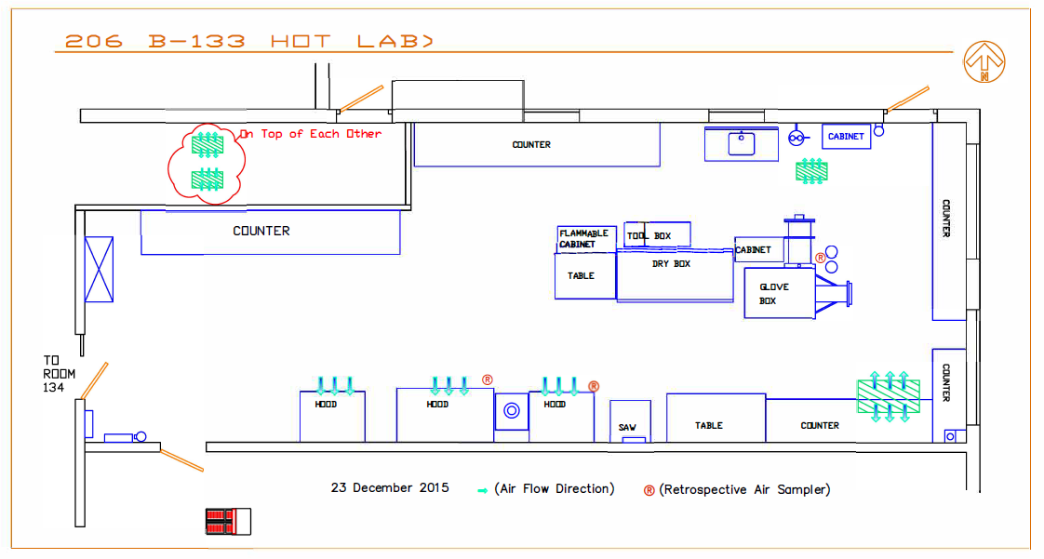
25
20
*10
18
23
24
19
*50
22
21
29
17
*18
16
26
*16
28
27
*12
9
13
15
12
30
*12
11
*15
7
14
*81
3
5
2
4
6
8
10
*10
1
#
= SMEAR
*#= Dose rate in μR/hr

Slide 3
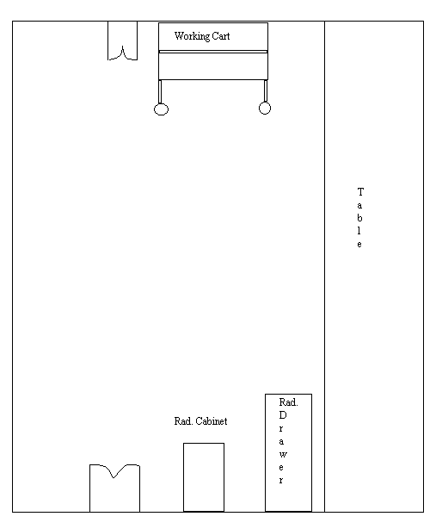
206 B134
#
= SMEAR
*# = Dose rate in μR/hr
34
*100
35
350
650
36
33
145
38
32
*120
37
*300
39
*250
31
*180
40

Slide 4
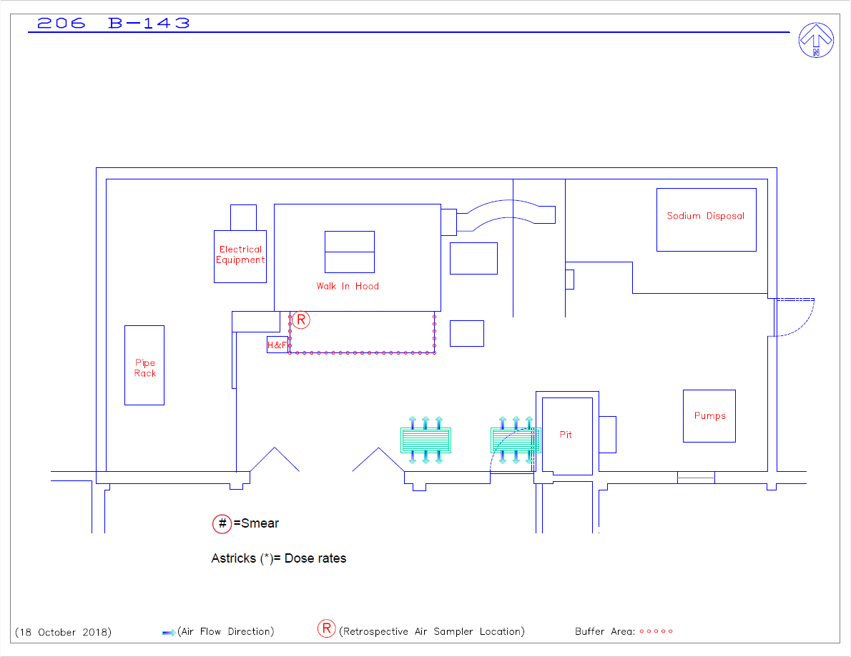
Survey: 20240823 E_W 206 RSQ 02
*18
*18
24
*15
9
*15
23
1
10
2
3
4
5
*18
19
17
13
11
6
*15
16
14
*19
8
7
20
12
22
18
*18
21
*16
15
*15

Slide 5
Survey: 20240823 E_W 206 RSQ 02
10
6
5
14
13
*12
*15
*11
4
9
15
3
*12
12
2
1
8
7
11
18
17
*14
16

Slide 6
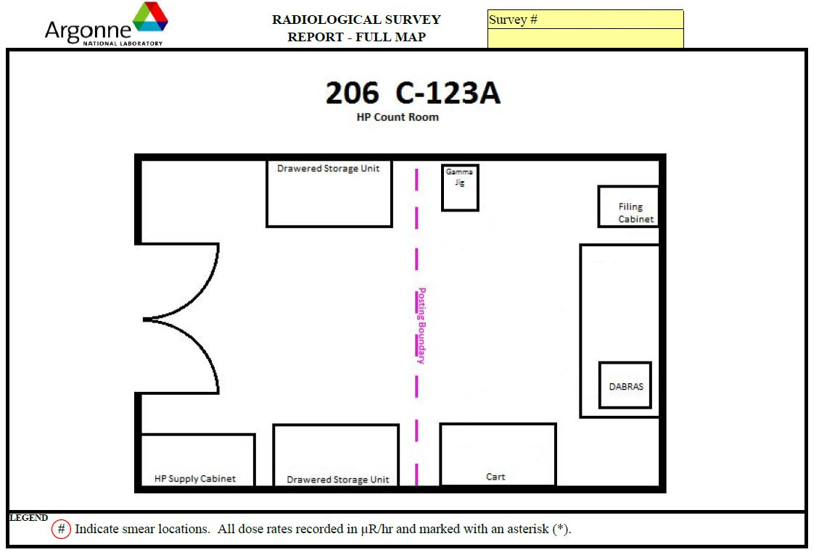
20250214 E_W 206 RSQ 01
2
18µR/hr​
6
8/µR/hr​
1
3
8µR/hr​
5
4

Slide 7
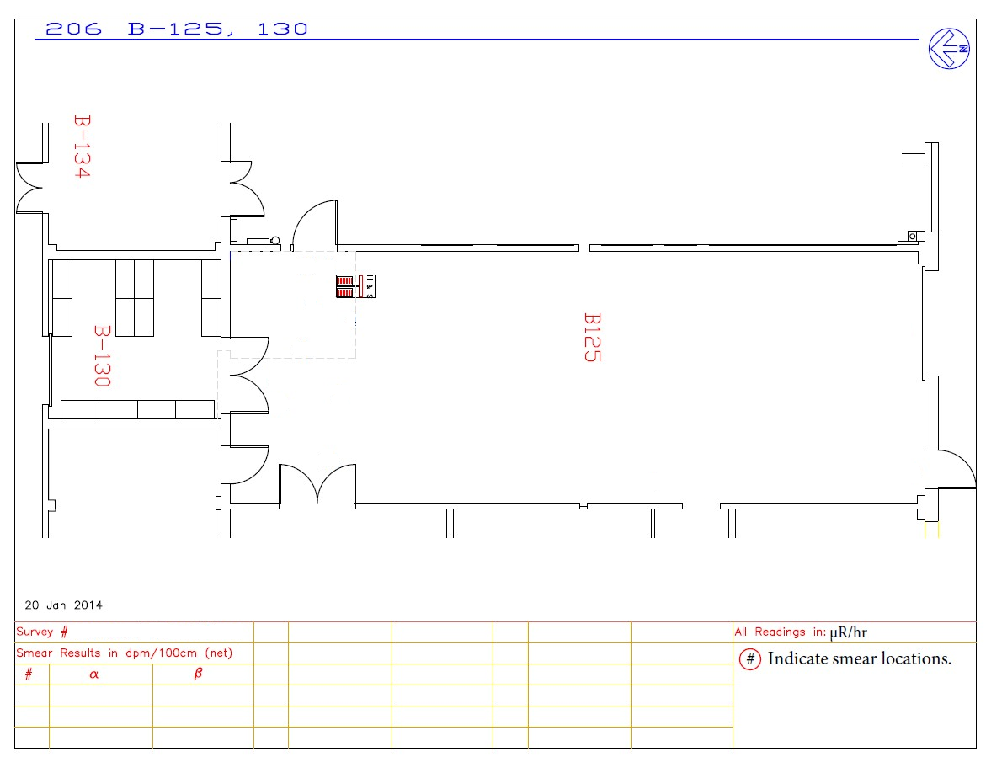
1
2
3
4
5
6
7
8
9
10
11
12

